Slide 1

BE AWARE OF FAKE NEWS ON WHATSAPP
RAJA SAHA
BCA_1B_48
ENROLLMENT NO : 12019004009099

Slide 2
FOUR WAYS TO IDENTYFY FAKE NEWS
CHECK THAT MESSAGE IS FORWARDED OR NOT
CHECK PHOTOS AND MEDIA CAREFULLY
LOOK OUT FOR MESSAGEES THAT LOOK DIFFERENT
VERIFY WITH OTHER SOURCES

Slide 3
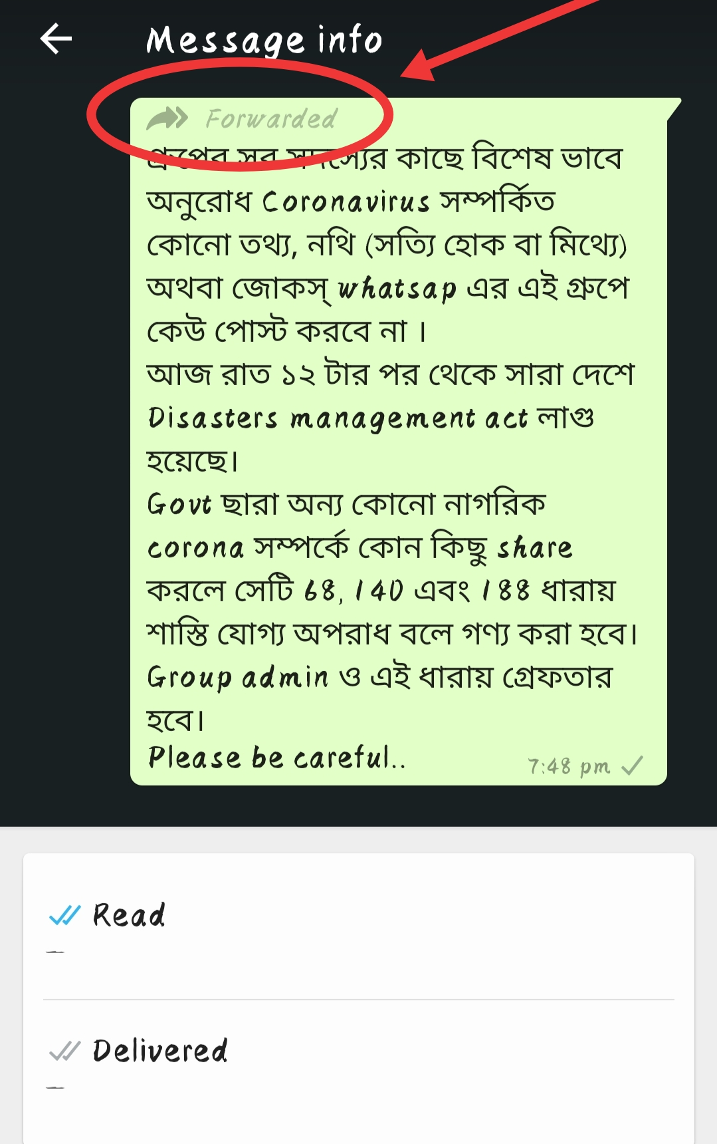
CHECK THAT MESSAGE IS FORWARDED OR NOT
A Message Labeled Forward Lets You Know If Your Friend Or Family Member Received That Message From Someone Else.
If It Is Forwarded More Than Five Times There Indicate a Double Arrow Icon
Double Check The Facts To Know More About The Forwarded Message

Slide 4

CHECK PHOTOS AND MEDIA CAREFULLY
The Photos Can Mislead You.
Audio Recordings , Call Recordings & Videos Can Also Spread Fake News.
Look For Trusted News Sources To Know The Truth.
If The Story Is Found In Any Trusted Source It Can Be True.

Slide 5

LOOK OUT FOR MESSAGEES THAT LOOK DIFFERENT
Many Received Messages Or Website Links Which Contains Fake News Have Spelling Mistakes
Look For These Signs To Accurate The News
Sometimes The Messages Look Awkward
Look For More Different Informations

Slide 6

VERIFY WITH OTHER SOURCES
If You Are Still Doubtful For a Message Search Online For Facts
Check Out Trusted News Sites To Know The Source Of The Story
Ask Fact - Checkers For The Truth Of The Message
If You Still Have Doubts ,Ask People You Trust For More Information

Slide 7


